Slide 1

Oriental institute of science & technology, Bhopal( m.p )
Electronics & Communication Engineering
Major Project Progress Presentation
on
“Estimated water level in storage tank
and predicting usage time”
Coordinator:
Dr. Parbhat Sharma, Prof. Sanjay Khadagade
Presented by:
Priyanshu Ray Shivshankar Chaudhary Satyam Tripathi
(0105EC211069) (0105EC211097) (0105EC211090)
Sonu Sharma Saumya Prakash
(0105EC211105) (0105EC211092)

Slide 2
Content
Introduction
Objective.
Components Used
Working & Principal Water level Prediction.
Circuit Diagram
Cost of the Project
Conclusion

Slide 3
Introduction
This IOT-based project aims to estimate the water level in a storage tank and predict water usage time. By integrating an ultrasonic sensor to measure water level and a flow sensor to monitor usage, real-time data is transmitted to a cloud platform. Users can remotely track water levels and consumption, enabling efficient management and conservation of water resources.

Slide 4
Objective
Measure Water Level: Use an ultrasonic sensor to measure the water level in a tank.
Monitor Water Usage: Use a flow sensor to track water usage over time.
Predict Usage Time: Calculate the estimated time left before the tank is empty based on current flow rate.
IoT Integration: Monitor water level and usage data remotely through a cloud platform like Blynk, Thingspeak, or Firebase.

Slide 5
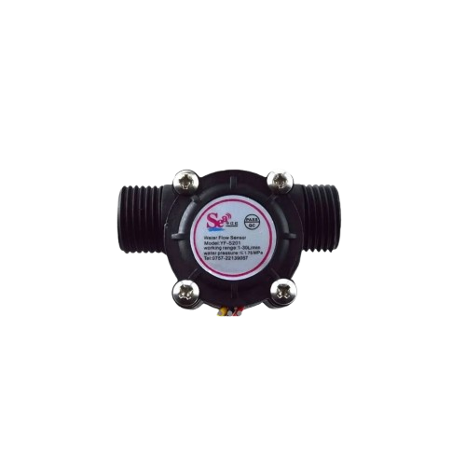
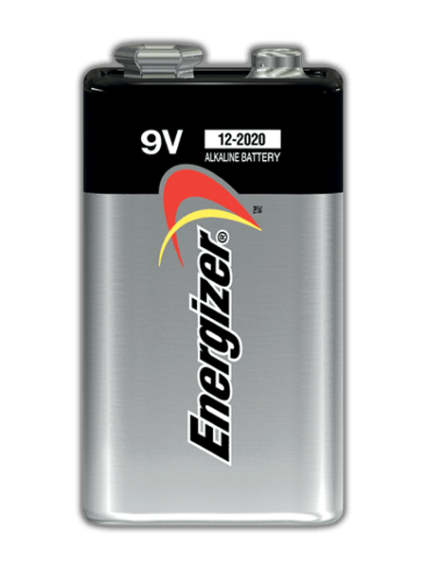
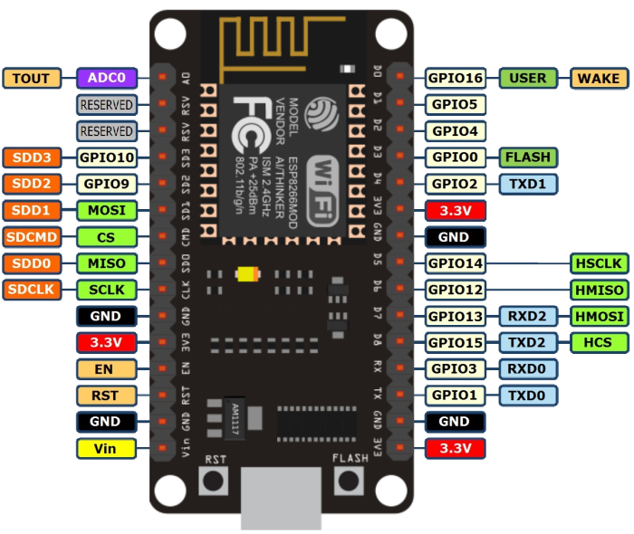
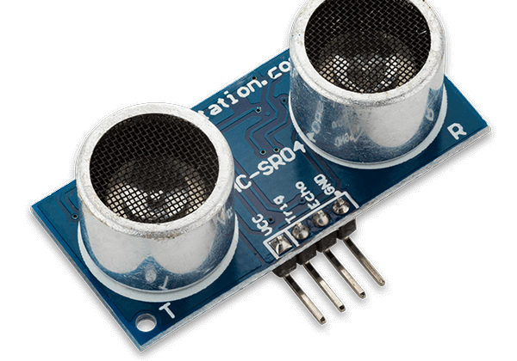
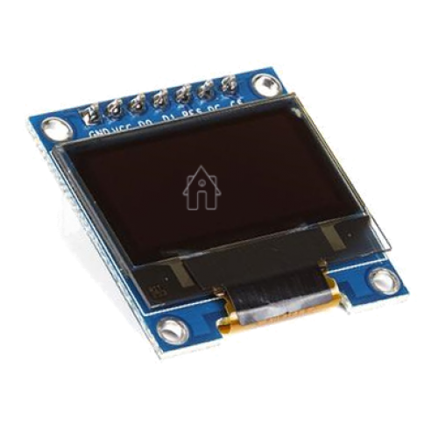
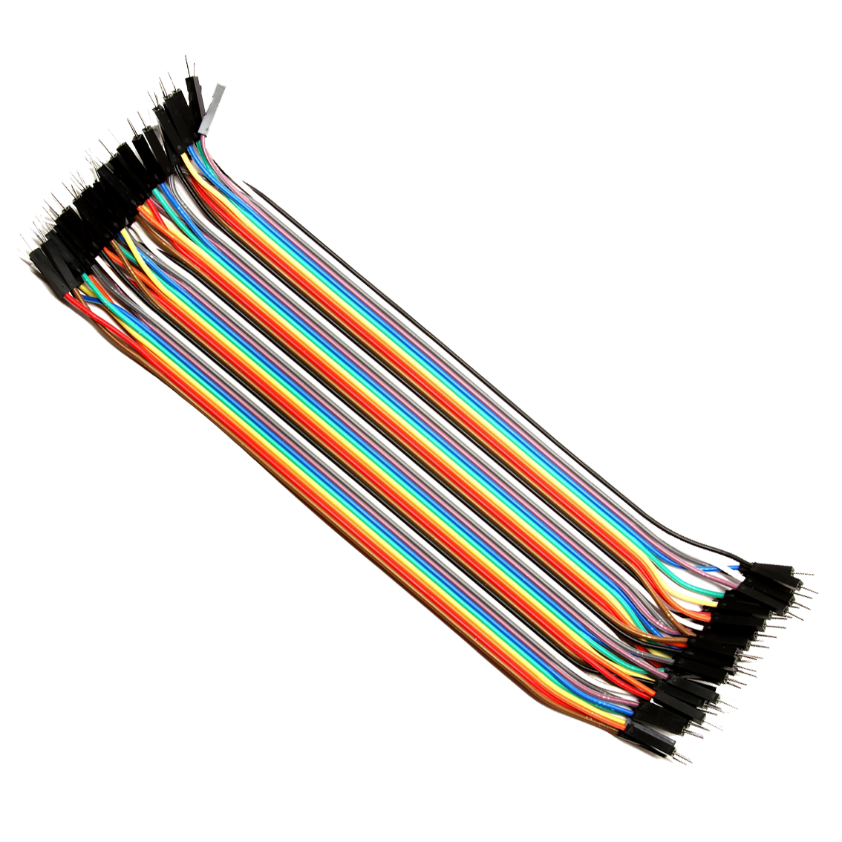
Components Used
NodeMCU ESP8266
Ultrasonic Sensor(HC-SR04)
Water Flow Sensor(YF-S201)
9v Battery
OLED Display
Jumper Wires

Slide 6
Working
Sensor Integration: An ultrasonic sensor measures the water level in the tank, while a flow sensor tracks the rate of water usage.
Data Processing: The ESP8266/ESP32 microcontroller processes data from both sensors to calculate the current water volume and flow rate.
Time Prediction: The system estimates the time left until the tank is empty based on the flow rate.
Cloud Communication: Data is transmitted to the Blynk app via Wi-Fi, allowing remote monitoring.
User Interface: Users can view real-time water levels, flow rates, and estimated usage time on their mobile devices.

Slide 7
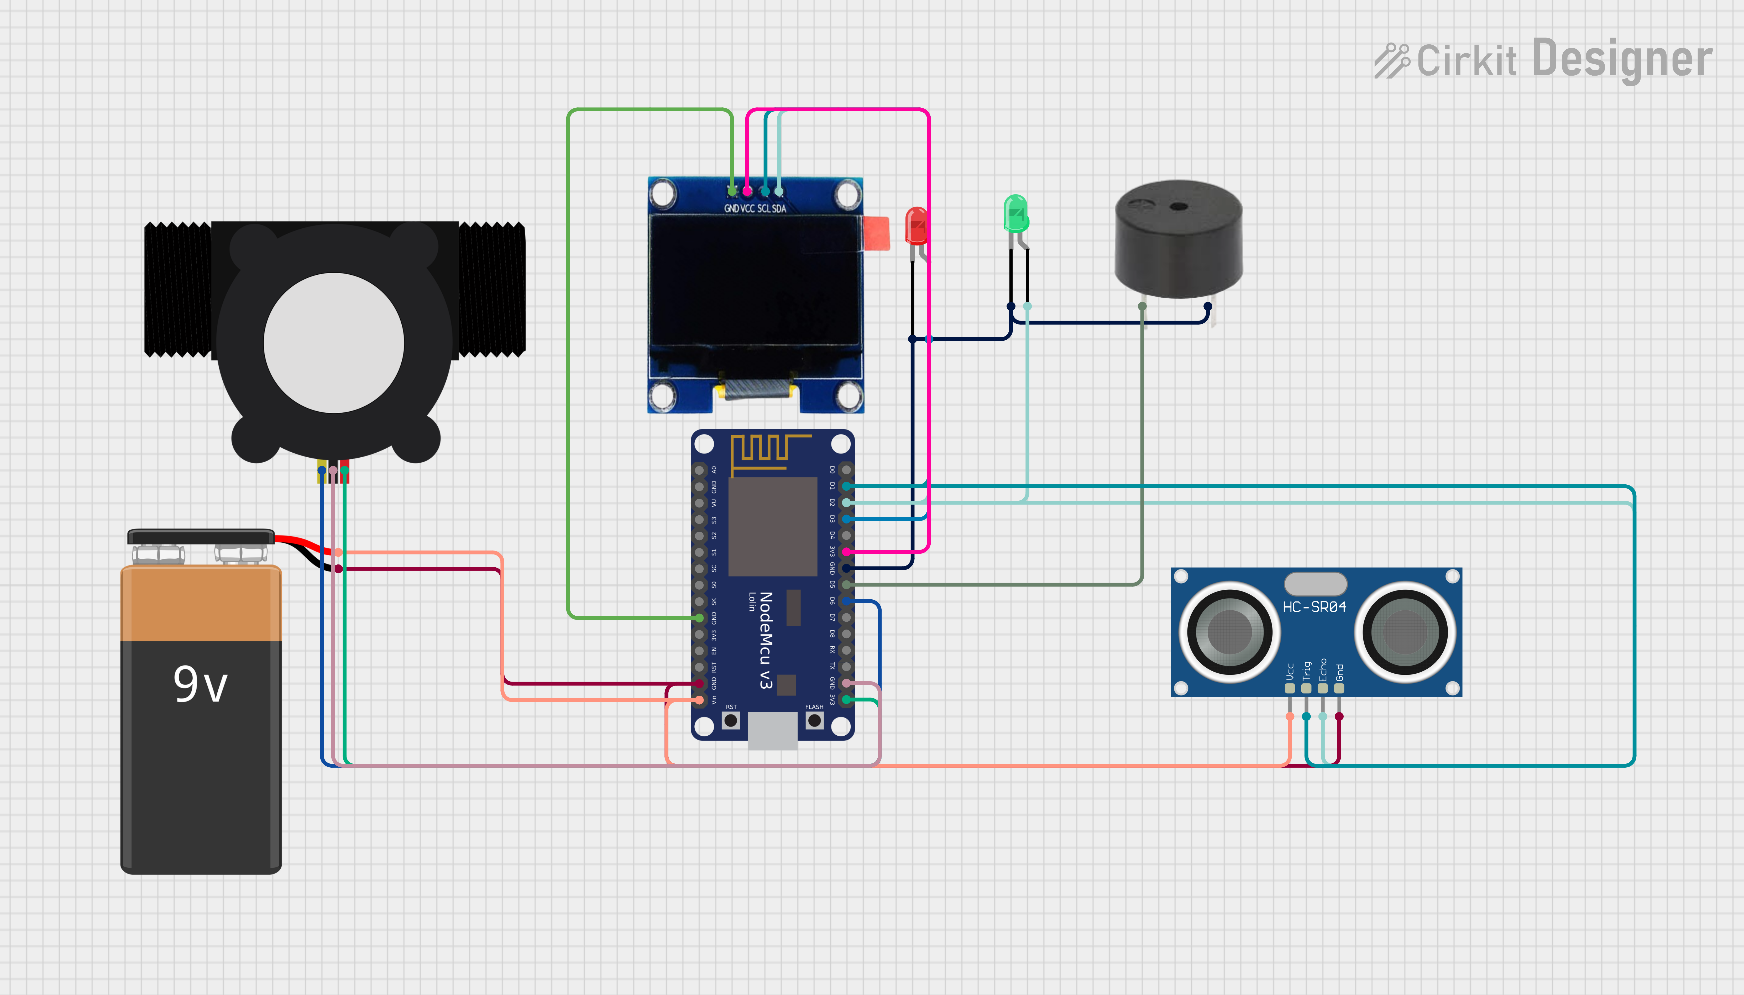
Circuit Diagram

Slide 8
Cost of the Project
S.No | Component | Quantity | Estimated Cost(INR) | Total Cost (INR)
1 | ESP8266 ( NodeMCU /ESP32) | 1 | 500-900 | 900
2 | Ultrasonic Sensor (HC-SR04) | 1 | 100-150 | 150
3 | Water Flow Sensor (YF-S201) | 1 | 600-900 | 900
4 | Jumper Wires | set | 20-40 | 40
5 | Breadboard or PCB | 1 | 30-60 | 60
6 | Power Supply (USB Adapter) | 1 | 200-250 | 250
7 | Blynk Subscription(Free to Pro) | optional |  | 400
8 | Miscellaneous (Resistors, Soldering) |  | 200-300 | 300
 | TOTAL COST |  |  | 3000/-

Slide 9
Conclusion
Finally, this project achieved a lot of its goals.
The Project implemented a low cost, low power.
Lists of accomplishments include portability, reliability and analog to digital conversion
the system can be easily accessible.

Slide 10
THANK YOU

